Slide 1
Insulation resistance
PowerPoint presentation
Unit 304: Electrical Installations: inspection, testing and commissioning

Slide 2
Insulation resistance
There are two main factors that affect the insulation resistance:
Length
Parallel circuits.

Slide 3

Insulation resistance
Length:
The insulation resistance of a length of cable is the resultant of a number of small individual leakage paths or resistances between the conductor and the cable insulation.
These leakage paths are distributed along the cable. Hence, the longer the cable the greater the number of leakage paths, and the lower the insulation resistance.
This is because each resistance, although very high in value, is in parallel with the others. As you will remember from electrical science, the more resistors connected in parallel the lower the total resistance.

Slide 4
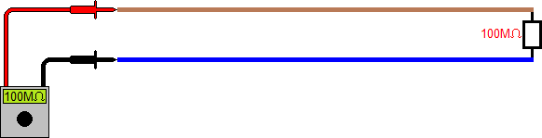
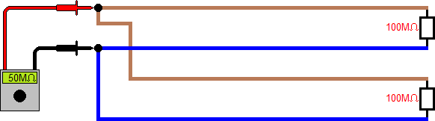
Insulation resistance
Parallel circuits: If two final circuits have a L-N insulation resistance of, say, 100MΩ each and an insulation resistance test is carried out on each individually, the reading will obviously be 100MΩ for each circuit.
Parallel circuits: If two final circuits have a L-N insulation resistance of, say, 100MΩ each and an insulation resistance test is carried out on each individually, the reading will obviously be 100MΩ for each circuit.
The more circuits connected to the consumer unit/distribution board the lower will be the insulation resistance.

Slide 5
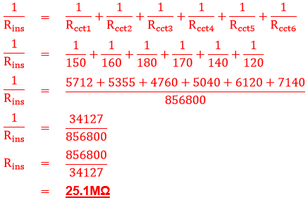
Insulation resistance
Example: A small domestic installation has six circuits connected into the consumer unit as follows: Cooker (Ins res – 150MΩ), Immersion heater (Ins res – 160MΩ), ring 1 (Ins res – 180MΩ), ring 2 (Ins res – 170MΩ), lighting 1 (Ins res – 140MΩ) and lighting 2 (Ins res – 120MΩ). Calculate the overall insulation resistance.

Slide 6
Insulation resistance
Insulation resistance testing is a fundamental test for inspectors.
These tests are to verify that the insulation of conductors provides adequate insulation, is not damaged and that live conductors or protective conductors are not short‑circuited.

Slide 7
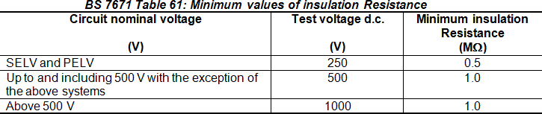
Insulation resistance
Type of test instrument
An insulation resistance tester should be used which is capable of providing a d.c. voltage as specified in Table 61 below. This table also specifies the minimum permitted value of insulation resistance.

Slide 8
Insulation resistance
Pre-test checks
Before commencing with insulation resistance tests, a number of checks should be made with precautions taken as follows:
The protective conductor of an item (switchgear or cable etc) is connected to the main earthing terminal.
Pilot or indicator lamps, and capacitors are disconnected from circuits to avoid an inaccurate test value being obtained.
Voltage‑sensitive electronic equipment such as dimmer switches, touch switches, delay timers, power controllers, electronic starters for fluorescent lamps, emergency lighting, RCDs and similar equipment are disconnected so that they are not subjected to the test voltage.

Slide 9
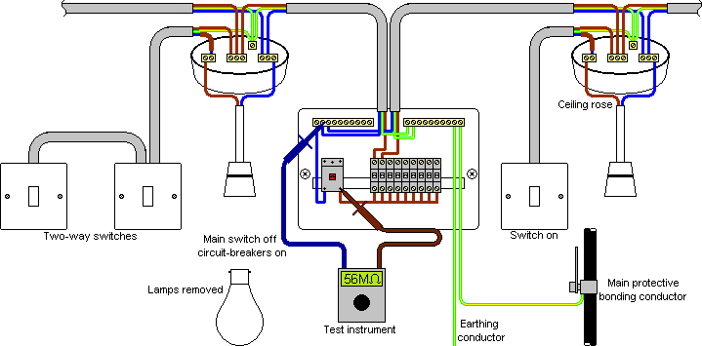
Insulation resistance
Insulation resistance test of the whole installation

Slide 10
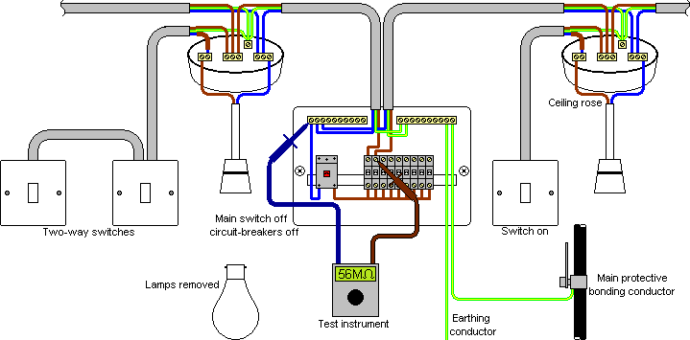
Insulation resistance
Insulation resistance test of a final circuit

Slide 11
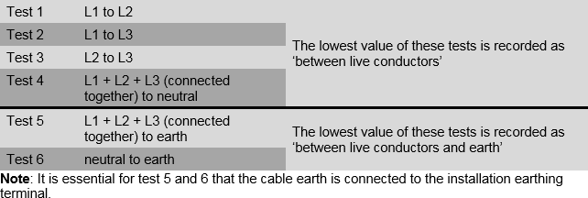
Insulation resistance
Table 2.3 (Guidance Note 3)

Slide 12
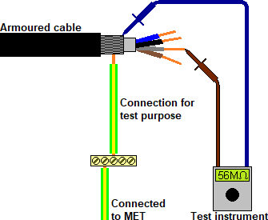
Insulation resistance

Slide 13
Any questions?

